Slide 1
GWAC_TE_Framework

Slide 2
Background Information
Over the past two decades, the use of demand response and other flexible distributed resources for electricity market efficiency and grid reliability has grown dramatically. Federal and state policy objectives point to an important role for customers’ loads, generation, and storage in the management of an increasingly unpredictable power system. As we consider the need to substantially scale the use of flexible distributed energy resources, growing attention has been devoted to the need to address not only the economics of the electricity grid, but also the control system implications, to address grid reliability.
The U.S. Department of Energy has supported the GridWise® Architecture Council (“the Council”) in developing a conceptual framework for developing architectures and designing solutions related to TE. The goal of this effort is to encourage and facilitate collaboration among the many stakeholders involved in the transformation of the power system and thereby advance the practical implementation of TE.
Source: GWAC_TE_Framework

Slide 3
1.0 Introduction: Contents
• clear definitions of TE
• explanations of technical and economic drivers motivating TE
• addressing of TE from multiple perspectives, including
– business and policy considerations
– business models
– value creation
• conceptual or reference architectures for TE systems
• identification of the implementation challenges of such systems.

Slide 4
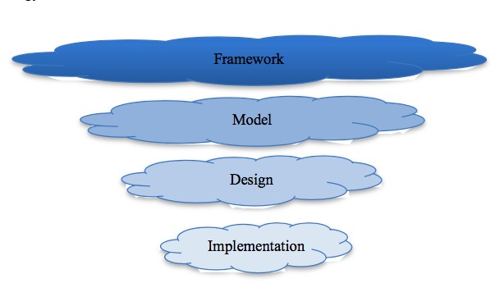
A framework provides high-level perspective
The intent of the TE framework is to promote discussion at the conceptual level of common features or elements of specific models, designs, or implementations of TE systems.

Slide 5
2.0 Context Setting
Problems TE faces
Growing interests in high-performance buildings as well as building-to-grid integration
The increasing use of intermittent resources in both the bulk power system and at end-use points served by distribution systems
The increased use of DER (Distributed Energy Resources), such as wind and solar power, has made it increasingly difficult to continue to use the load-following operational model
Etc..

Slide 6
• wholesale prices/production costs minimization
• need for stronger coordination at transmission-distribution interchange points
• provision of ancillary services, ramping, and balancing (especially in light of renewables)
• managing transmission congestion costs
• peak load management
• resource ramp management
• minimization of new transmission capacity, relief from existing dynamically constrained capacity limits
• minimization of new distribution capacity
• management of distribution voltages in light of rapid fluctuations in rooftop PV system output
• accommodation of new loads and integration of responsive loads
• maintenance or improvement of the services power provides in homes and buildings.
New objectives arising from the emerging issues discussed above are as follows:

Slide 7
How do we solve those problems and achieve those objectives mentioned in previous slides?
There have typically been two approaches to achieving the operational objectives of the electric power system: the use of economic systems such as markets and the use of control systems technology.

Slide 8
3.0 Transactive Energy

Slide 9
4.0 Framework
. 4.1 Policy and Market Design
. 4.2 Business Models and Value Realization
. 4.3 Conceptual Architecture Guidelines

Slide 10
4.1 Policy and Market Design
This section covers a detailed discussion of policy considerations. These include traditional concerns, such as system reliability and resilience; they also include new concerns arising from the increasing adoption of DERs and the variability of renewable energy resources, which will provide a larger portion of the power mix as costs decrease and customer demand increases. Other policy considerations include cost and risk allocation issues associated with increased customer participation in electricity generation and markets, and growing customer control over their own demand. There are also policy and market design considerations stemming from TE.
Under this circumstance, many policy issues must be addressed to ensure that balancing the supply and demand of resources is successful.

Slide 11
Policy and Market Design
. Objectives that support customer value and the economics-of-control principles that policy makers desire when designing markets and/or policies likely include the following:
• creating a more level playing field for all stakeholders while avoiding cost-shifting
• respecting ownership, jurisdictional boundaries, and customer privacy
• expanding opportunities for engagement between customers and the grid
• allowing customers more control of their relationships with the energy infrastructure
• understanding and proper allocation of all costs and risks
• increasing customer choice to provide services to the system and purchase services from it as both producers and consumers of energy
• spurring technical and commercial innovation
• recognizing and accounting for effects on the economics and business models of current key entities such as nonparticipating customers and the load-serving entities
• optimizing system reliability vs. capital infrastructure investment.

Slide 12
4.2 Business Models and Value Realization
This section reviews the current landscape of potential DER value streams within the broader TE conceptual structure and describes the current status of DER value realization, the advancement efforts underway, the main challenges, and potential solutions.
Section 4.2.1 gives an overview of the services DERs can provide to energy end users and to the electric power system.
Section 4.2.2 focuses on services that are well recognized today, distinguishing between those DERs are already providing and being compensated for versus those for which some open issues need to be resolved.
Section 4.2.3 describes potentially significant DER values that are not yet recognized, much less quantified and defined as services that can be compensated.
Section 4.2.4 discusses transactive markets and peer-to-peer (P2P) transactions.
Section 4.2.5 discusses potential alternative DSO models.
Section 4.2.6 summarizes the section with a discussion of how to reframe the “value of the grid” for a high-DER transactive electric power system.

Slide 13
4.2.3.3 Resilience and Microgrids
According to the National Infrastructure Advisory Council (2009) the critical infrastructure resilience is defined as “the ability to reduce the magnitude and/or duration of disruptive events. The effectiveness of a resilient infrastructure or enterprise depends upon its ability to anticipate, absorb, adapt to, and/or rapidly recover from a potentially disruptive event.”

Slide 14
4.2.3.3 Resilience and Microgrids
Resilience enhancement measures and a set of potentially useful metrics for further research.
Resilience enhancement measures: The following three categories of measures can help enhance resilience of a power system. For each category, we distinguish conventional measures from new measures that could leverage DERs, microgrids, and new technologies.
• Grid Hardening: This involves investment in grid infrastructure.
– Conventional measures: generation, transmission, and distribution upgrade investments
– Additional new measures: microgrids; leveraging DR/DERs (non-wires alternatives)
• Vigilance and Early Detection
– Conventional measures: fault location and isolation; Remedial Action Schemes
– Additional new measures: a number of emerging standards for both grid and grid-edge system operations, including ride-through standards (e.g., IEEE 1547-2018 [IEEE 2018]), microgrid interconnection standards, etc.
• Speedy Restoration
– Conventional measures: manual system restoration
– Additional new measures: automatic self-healing capabilities

Slide 15
Possible types of metrics to quantify resilience:
• metrics based on early detection and self-healing capabilities (resilience measure compared to status quo)
– reduction of the geographical scope of the effect of probable extreme events
– reduction of the effective impact intensity of the extreme events
– reduction of the duration of effects of the extreme events
– reduction of the effects of probable extreme events on loss of human life
– reduction of the effects of probable extreme events on economic losses
– Etc…

Slide 16
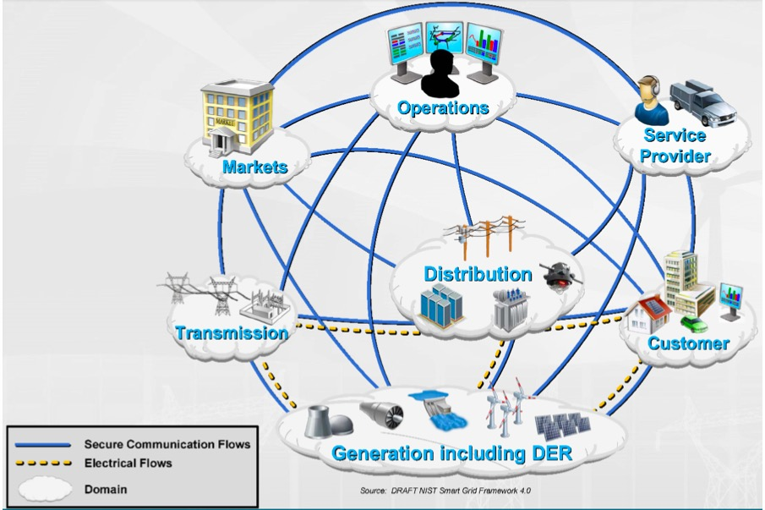
4.3 Conceptual Architecture Guidelines
The section is to provide guidance on the creation of a conceptual architecture for TE. This section does not provide such an architecture; that work would be done by a core team of experienced system architects and would represent the design of a specific example of a TE system. Rather, it suggests key elements and principles to be considered in development of the TE Conceptual Architecture (Figure 9), building upon principles and content.

